Slide 1
Final Presentation

Slide 2

Resume Information Extraction
Benefits:
Automating workflows.
Time saved.
Talent identification eased.

Slide 3
Statistical Analysis of the Data

Slide 4
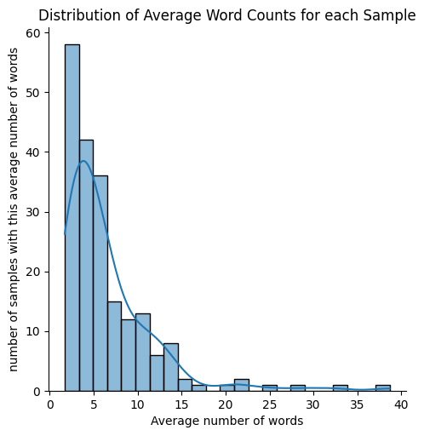
The average number of extracted words is around 5.

Slide 5
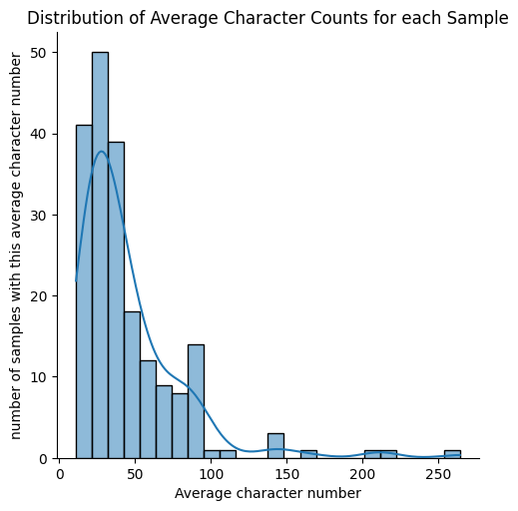
Average character counts is around 30

Slide 6
Proposed Modeling technique
Sequential embeddings of tokens from the input text and similarity comparisons with a general semantic embedding of skills.

Slide 7
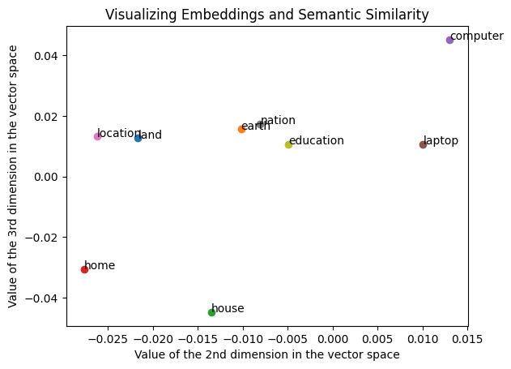
We want words with similar semantic meanings to have a similar vector representation.

Slide 8
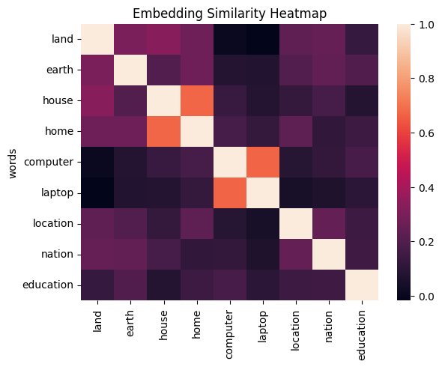
We want all words with a semantic similarity with general skills to extract to be selected from the input.

Slide 9
Models Used

Slide 10
First Model
The first model is one that that look iteratively at the similarity between the embeddings of successive parts of the resume and key single or small group of words we chose.
It extracts the parts with a similarity score higher than a threshold for at least one keyword.
The efficiency of this model is in the use of strong embedding features, especially trained on resume extraction tasks.

Slide 11
Second Model
The second model is a large model trained for summarization tasks.
The model is taken from HuggingFace.
The benefit of the model is the ability to output text that is not only a selection of parts from the resume.
However, sometimes the output may be less information dense with some grammatical structure added (“cloud computing” and “he is a professional in cloud computing”).

Slide 12
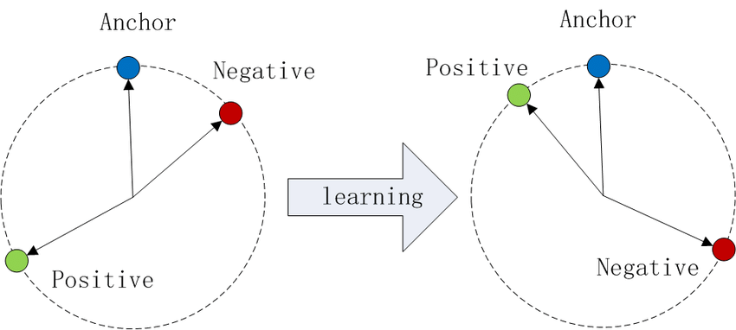
Technical Detail
An approach for training the embeddings is to use triplet loss.
The goal is to train an anchor vector to be similar to our label (positive). Additionally, a “negative” sample can be used to increase dissimilarity with unwanted samples.

Slide 13
END

